Slide 1
Deep Learning Based Seed Classification and Quality Detection
Team ID: PG1-13 Panel Number: 05
Project Advisor:
Dr.B. Uma Maheswari / Assistant Professor(SG) / CSE
S.No | Reg.No | Name of the Student | Section
1 | BL.EN.U4CSE18069 | Matta Saatwika | CSE B
2 | BL.EN.U4CSE18112 | Sanka Devadutt | CSE B
3 | BL.EN.U4CSE18133 | Madhulika Varanasi | CSE B

Slide 2
Introduction
Seeds contain all the starting materials necessary to turn out to be complex plants. Thanks to this, they're extremely nutritious. Seeds are great sources of fiber.
Generally, the classification of seeds depends on the characteristics of color, shape, and texture.
We introduced convolutional neural networks (CNNs) into the classification of seeds. In our project we mainly focused on detecting the quality and type of seeds specifically for moongdal , pigeon pea ,groundnuts.

Slide 3
Motivation
Seeds are typically high in dietary fiber, a nutrient that plays a central role in digestive health. Seeds are great sources of fiber. They also contain healthy fats and plenty of necessary vitamins, minerals and antioxidants. When consumed as a part of a healthy diet, seeds can help reduce blood glucose, cholesterol and pressure level.
Classification of seeds depending on the characteristics of color, shape, and texture requires repeated extraction of an outsized amount of feature information, which isn't efficiently employed in detection.

Slide 4
Problem Definition
To design a CNN based model for classification and quality detection of moongdal, pigeon pea, groundnuts.

Slide 5
Literature Survey
S.No | Authors names | Paper title | Inference from paper
1 | Jamuna et al | Classification of Seed Cotton Yield Based on the Growth Stages of Cotton Crop Using Machine Learning Techniques( june 2010) | Naïve Bayes classifier had the highest error rate
2 | Rozman and Stajnko | Assessment of germination rate of the tomato seeds using image processing and machine learning(2015) | ANN performed best in seed classification among all algorithms
3 | Agrawal and Dahiya | Comparisons of classification algorithms on seeds dataset using machine learning algorithm(2018) | LDA had the superior performance among all linear and non-linear algorithms

Slide 6
Literature Survey
S.No | Authors names | Paper title | Inference from paper
4 | Taylor, J.; Chiou, C.P.; Bond, L.J | A methodology for sorting haploid and diploid corn seed using terahertz time domain spectroscopy and machine learning( 2012) | 75% accuracy with 5-fold cross-validation
5 | Vlasov and Fadeev | A machine learning approach for grain crop’s seed classification in purifying separation(2017) | DL approach had a classification accuracy of 95%, while standard learning had around 75%.
6 | Kiratiratanapruk, K. | A. Development of Paddy Rice Seed Classification Process using Machine Learning Techniques for Automatic Grading Machine.(2020) | The best accuracy from the DL techniques was obtained from the InceptionResNetV2 model

Slide 7
Literature Survey
S.No | Authors names | Paper title | Inference from paper
7 | Ali, A.; Qadri, S.; Mashwani | Machine learning approach for the classification of corn seed using hybrid features(2020) | MLP reported outstanding classification accuracy (98.93%) on ROIs size (150 × 150)
8 | Xinshao | Weed Seeds Classification Based on PCANet Deep Learning(2015) | This study minimised the limitation of manual feature extraction by learning features from the dataset
9 | Qiu, Z.; Chen, J.; Zhao, Y.; Zhu, S.; He, Y.; Zhang, C | Variety identification of single rice seed using hyperspectral imaging combined with convolutional neural network(2018) | They reported that CNN outperformed knn and svm

Slide 8
Justification for the Proposed Problem
Motivation and Need:
Agriculture has benefited greatly from AI since it provides flexibility, high performance, precision, and low-cost solutions to a variety of challenges
In AI, traditional ML techniques have been widely applied in object identification and classification.
Feature extraction in traditional ML techniques mainly relies on user-specified features that may cause the loss of some important information, due to which researchers are then faced with difficulty in getting accurate results.
Deep learning techniques determine the features of the images in different layers instead of relying on the self-made features of the images

Slide 9
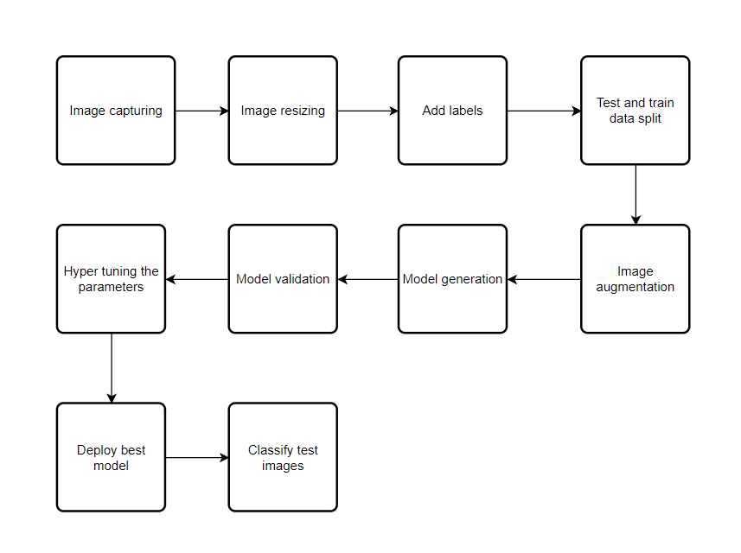
Design

Slide 10
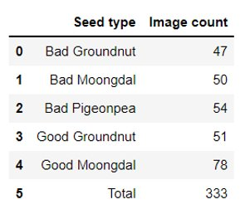
Data Set
Three different types of well-known seeds were chosen for the dataset construction in this study. Moongdal , pigeon pea ,groundnuts were the chosen seeds, as shown in Table.

Slide 11
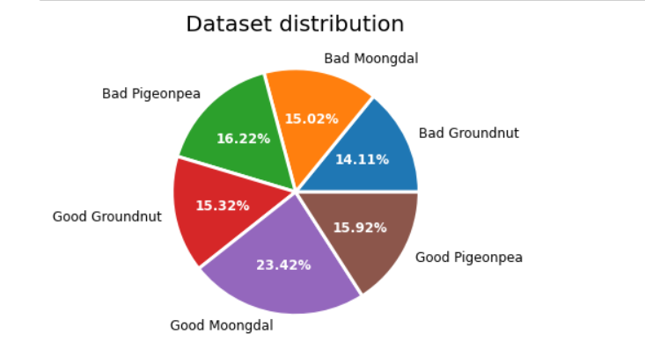
Data Set
Data set collection of three seeds categorizing them as good and bad

Slide 12
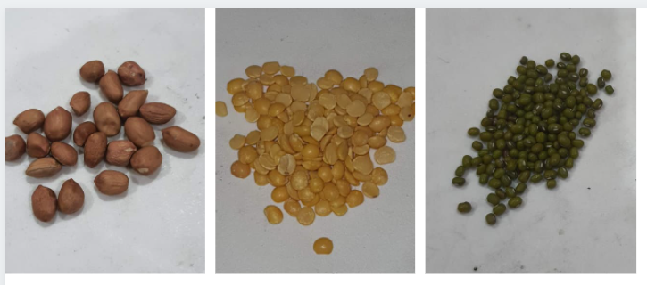
Data Set
Good Seeds

Slide 13
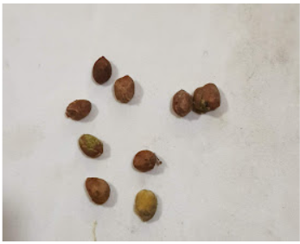
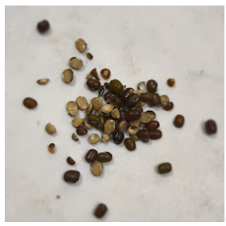
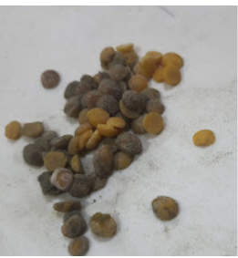
Data Set
Bad Seeds

Slide 14
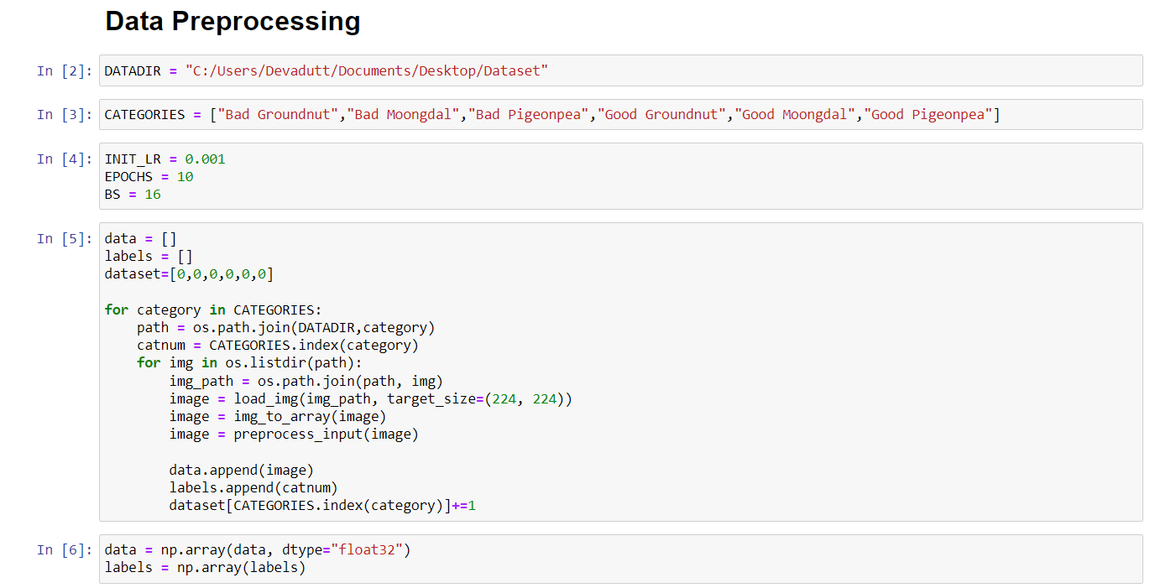
Implementation

Slide 15
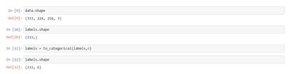
Implementation

Slide 16
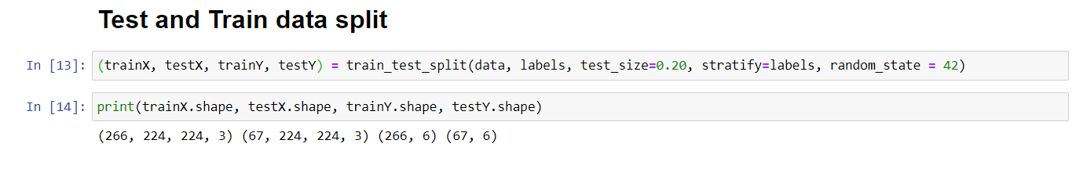
Implementation

Slide 17
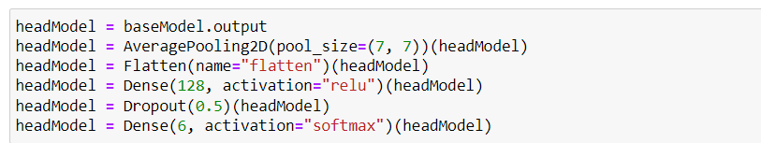
Implementation
Importing pre-trained model
l
Freezing layers in the mode

Slide 18
Implementation
Modification of the model
Model compilation

Slide 19
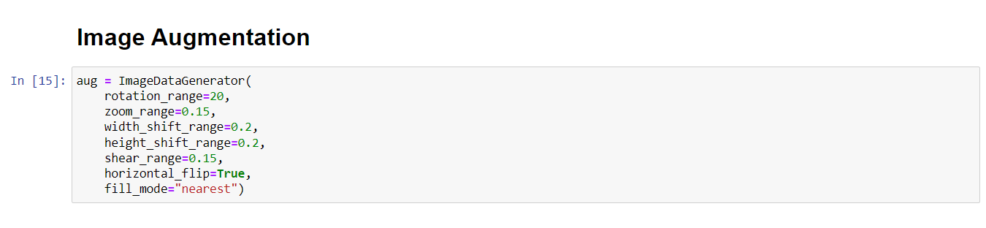
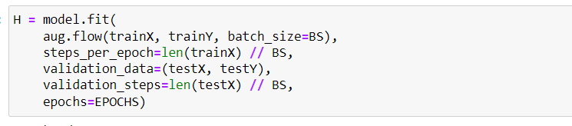
Implementation
Model Training

Slide 20
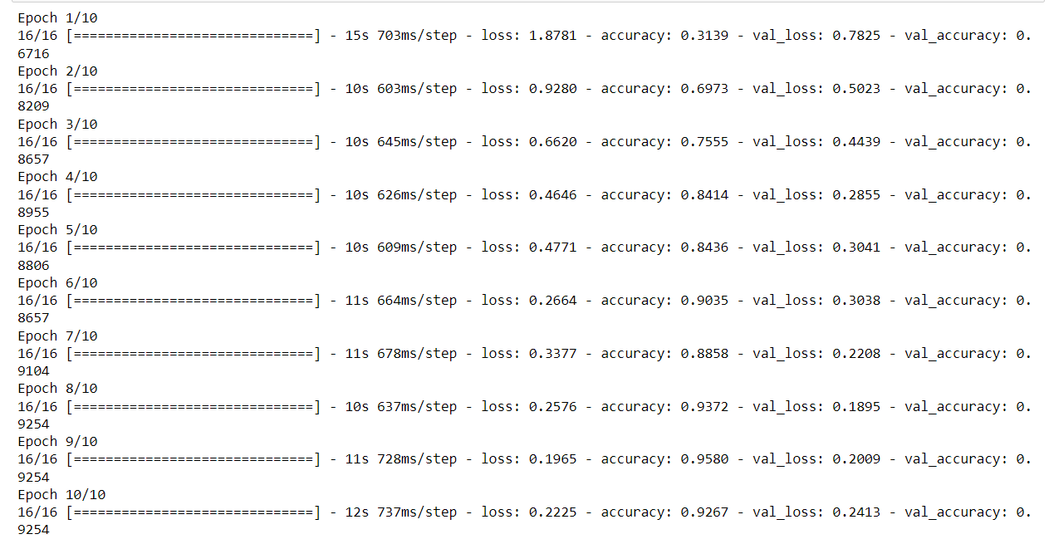
Implementation

Slide 21
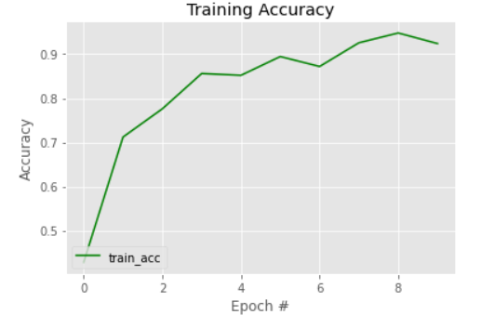
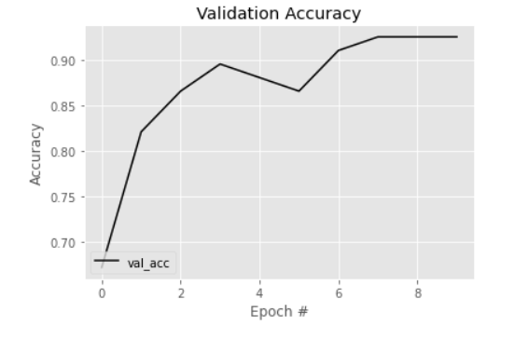
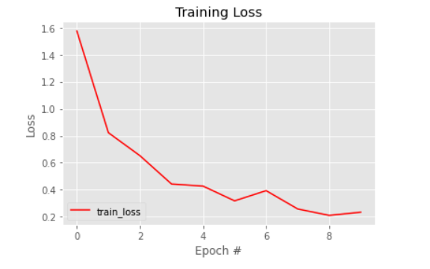
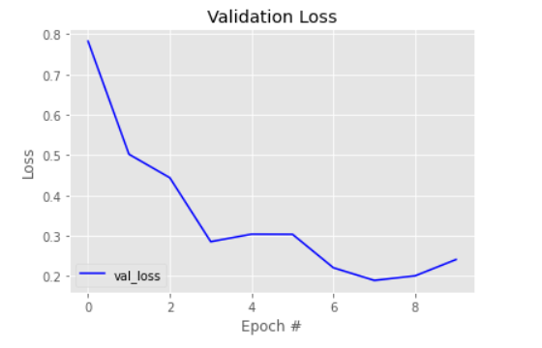
Implementation

Slide 22
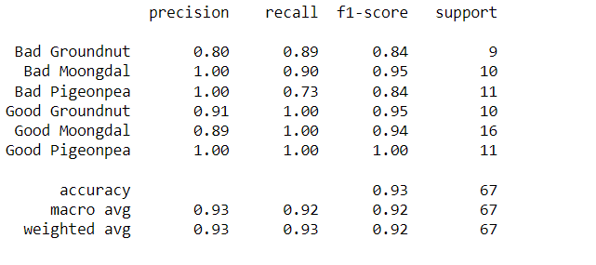
System Testing and Test Cases
Testing
Model Testing

Slide 23
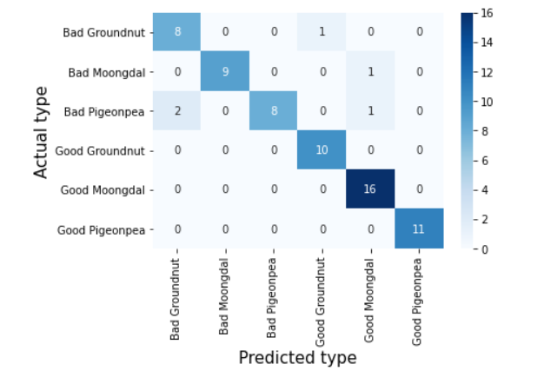
System Testing and Test Cases
Confusion Matrix of testing

Slide 24
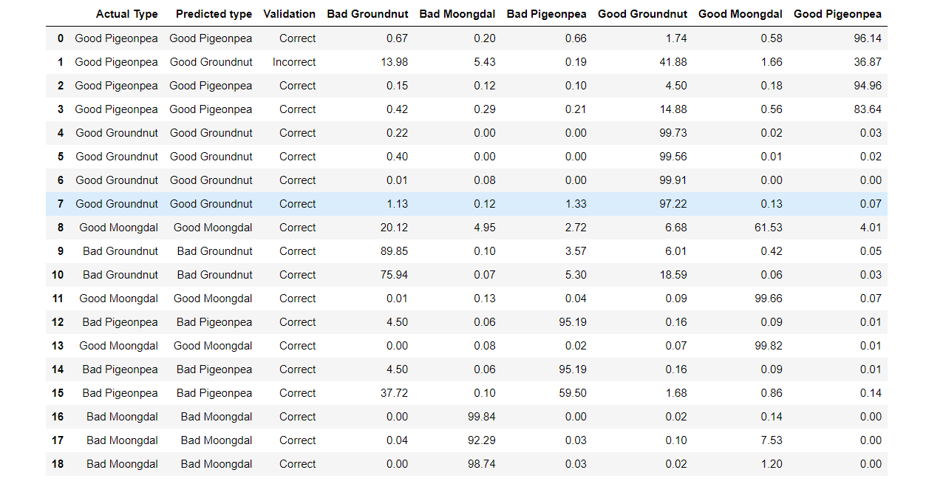
Results
Model prediction on unseen data

Slide 25
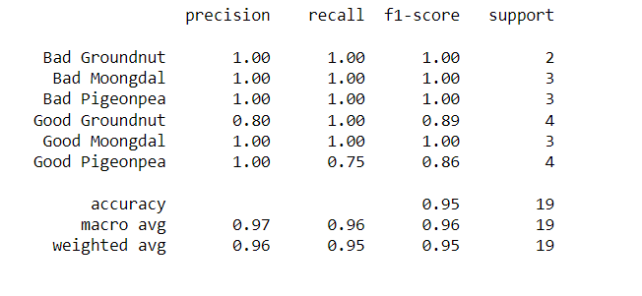
Results
Classification report on new data

Slide 26
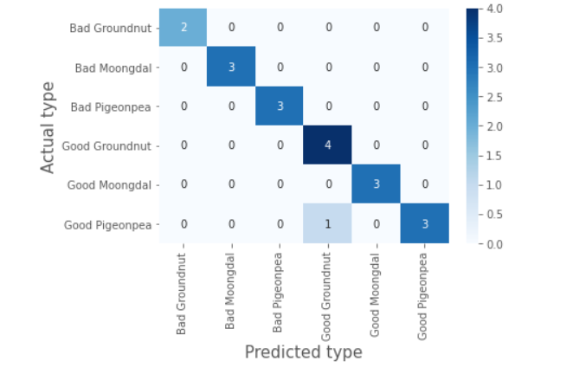
Results
Confusion Matrix of unseen data

Slide 27
Conclusion
This project proposed an efficient model for seed classification and quality detection. The model was trained for different epochs but the best model was achieved when epochs were 10. We have decided the epochs as 10 by observing the trend in training accuracy and loss while training the model as after 10 epochs the model is showing fluctuations.

Slide 28
Future Scope
We can deploy this model in Android Application and make it more user-friendly
We can expand the data set and exposure of various seeds can be improved

Slide 29
References
Jamuna, K.S.; Karpagavalli, S.; Vijaya, M.S.; Revathi, P.; Gokilavani, S.; Madhiya, E. Classification of Seed Cotton Yield Based on the Growth Stages of Cotton Crop Using Machine Learning Techniques. In Proceedings of the ACE 2010–2010 International Conference on Advances in Computer Engineering, Bangalore, India, 20–21 June 2010; pp. 312–315.
Qiu, Z.; Chen, J.; Zhao, Y.; Zhu, S.; He, Y.; Zhang, C. Variety identification of single rice seed using hyperspectral imaging combined with convolutional neural network. Appl. Sci. 2018, 8, 212.
Kiratiratanapruk, K.; Temniranrat, P.; Sinthupinyo, W.; Prempree, P.; Chaitavon, K.; Porntheeraphat, S.; Prasertsak, A. Development of Paddy Rice Seed Classification Process using Machine Learning Techniques for Automatic Grading Machine. J. Sens. 2020, 2020, 7041310.
Luan, Z.; Li, C.; Ding, S.; Wei, M.; Yang, Y. Sunflower Seed Sorting Based on Convolutional Neural Network. In Proceedings of the ICGIP 2019 Eleventh International Conference on Graphics and Image Processing, Hangzhou, China, 12–14 October 2019; Pan, Z., Wang, X., Eds.; SPIE: Bellingham, WA, USA, 2020; Volume 11373, p. 129
Rozman, C. Denis Stajnko Assessment of germination rate of the tomato seeds using image processing and ˇ machine learning. Eur. J. Hortic. Sci. 2015, 80, 68–75
Taylor, J.; Chiou, C.P.; Bond, L.J. A methodology for sorting haploid and diploid corn seed using terahertz time domain spectroscopy and machine learning. AIP Conf. Proc. 2019, 2102.

Slide 30
References
Ali, A.; Qadri, S.; Mashwani, W.K.; Brahim Belhaouari, S.; Naeem, S.; Rafique, S.; Jamal, F.; Chesneau, C.; Anam, S. Machine learning approach for the classification of corn seed using hybrid features. Int. J. Food Prop. 2020, 23, 1097–1111.
Eli-Chukwu, N. Applications of Artificial Intelligence in Agriculture: A Review. Eng. Technol. Appl. Sci. Res. 2019, 9, 4377–4383
Agrawal, D.; Dahiya, P. Comparisons of classification algorithms on seeds dataset using machine learning algorithm. Compusoft 2018, 7, 2760–2765
Vlasov, A.V.; Fadeev, A.S. A machine learning approach for grain crop’s seed classification in purifying separation. J. Phys. Conf. Ser. 2017, 803, 012177.
Maeda-Gutiérrez, V.; Galván-Tejada, C.E.; Zanella-Calzada, L.A.; Celaya-Padilla, J.M.; Galván-Tejada, J.I.; Gamboa-Rosales, H.; Luna-García, H.; Magallanes-Quintanar, R.; Guerrero Méndez, C.A.; Olvera-Olvera, C.A. Comparison of convolutional neural network architectures for classification of tomato plant diseases. Appl. Sci. 2020, 10, 1245
Krizhevsky, A.; Sutskever, I.; Hinton, G.E. ImageNet Classification with Deep Convolutional Neural Networks. In Proceedings of the Advances in Neural Information Processing Systems 25 (NIPS 2012), Lake Tahoe, NV, USA, 3–6 December 2012; pp. 1097–1105.

Slide 31
References
Szegedy, C.; Liu, W.; Jia, Y.; Sermanet, P.; Reed, S.; Anguelov, D.; Erhan, D.; Vanhoucke, V.; Rabinovich, A. Going Deeper with Convolutions. In Proceedings of the IEEE Conference on Computer Vision and Pattern Recognition, Boston, MA, USA, 7–12 June 2015; pp. 1–9.
Szegedy, C.; Vanhoucke, V.; Ioffe, S.; Shlens, J.; Wojna, Z. Rethinking the Inception Architecture for Computer Vision. In Proceedings of the IEEE Computer Society Conference on Computer Vision and Pattern Recognition, Las Vegas, NV, USA, 27–30 June 2016; pp. 2818–2826
He, K.; Zhang, X.; Ren, S.; Sun, J. Deep Residual Learning for Image Recognition. In Proceedings of the Proceedings of the IEEE Conference on Computer Vision and Pattern Recognition, Las Vegas, NV, USA, 27–30 June 2016; pp. 770–778
Feature Detection and Analysis of Pigeon Peas Using Image Processing

Slide 32
THANK YOU

